Slide 1

Elements in Biological System (classification based on action)
University of Delhi, Bioinorganic Chemistry
Rohan Singh, Nutan Sharma, Diskshita
Bsc (H) Chemistry, Sem-6, sec-b

Slide 2
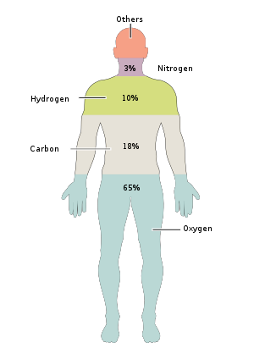
Elements In Our Body
Almost 99% of the mass of the human body is made up of six elements -> Oxygen, Carbon, Hydrogen, Nitrogen, Calcium, and Phosphorus.
Only about 0.85% is composed of other five elements -> Potassium, Sulphur, Sodium, Chlorine and Magnesium. All these 11 elements are essential for life.
The remaining are trace elements, of which more than a dozen are considered necessary for life on basis of good evidence. All of the mass of the trace elements put together (less than 10 grams for a human body) do not add up to the body mass of magnesium, the rarest of the 11 non-trace elements.
1

Slide 3
Classification of Elements on basis of action in biological system
Elements
Essential
O, C, H, N, P, Na, K,
Mg, Cl, Ca, S
Non Essential
Al, Sr, Ba, Sn
Trace
I, Fe, Cu, Zn, Mn,
Co, Mo
Toxic
Hg, Cd, Pb, As
Essential elements are absolutely essential or necessary for life processes.
Trace elements are also necessary for life processes.
Non-essential elements are not essential. If they are absent other elements may serve the same function.
Toxic elements disturb the natural functions of the biological system.
2

Slide 4
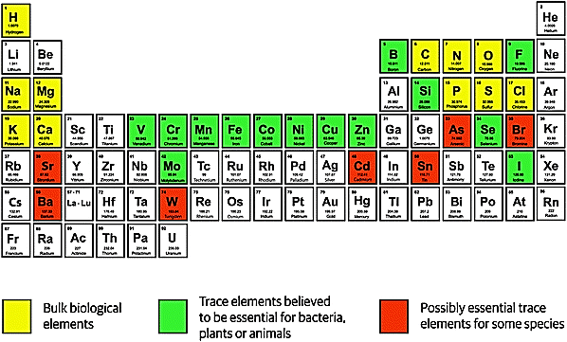
3

Slide 5
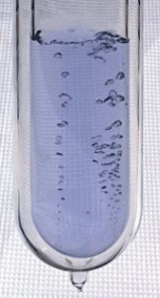
Essential Elements
Liquid Oxygen
1. Oxygen (O) (65% of body weight)
Oxygen is the most abundant element in the human body. It’s mainly found bound to hydrogen in the form of water. Water, in turn, makes up about 60% of the human body and participates in countless metabolic reactions.
The element oxygen acts as an electron acceptor and oxidizing agent. It is found in all four of the major classes of organic molecules: protein, carbohydrates, lipids, and nucleic acids. Because it is a key element in aerobic cellular respiration, large amounts of oxygen are found in the lungs and in the bloodstream. Hemoglobin in blood bind the oxygen molecule, O₂, from inhaled air. Oxygen is used by the mitochondria in cells to produce the energy molecule adenosine triphosphate or ATP. While it’s essential for human life, too much oxygen can be deadly, as it can lead to oxidative damage to cells and tissues.
4

Slide 6

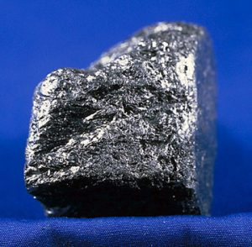
2. Hydrogen (H) (10% of body weight)
Most of the hydrogen in the body is bound with oxygen to form water, H₂O.
Hydrogen, like carbon, is found in every single organic molecule in the body. It also acts as a proton or positive ion in chemical reactions.
Hydrogen Discharge Tube
3. Carbon (C) (18% of body weight)
Carbon is the second most abundant element in the human body and the element that is considered the basis of organic chemistry.
Every single organic molecule in our body contains carbon. The element bonds to itself to form chains and ring structures that serve as the basis for all metabolic reactions in the body.
Carbon in carbon dioxide is expelled as a waste product when we breathe.
Graphite (Allotrope of C)
5

Slide 7

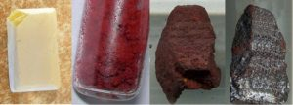
4. Nitrogen (N) (3% of body weight)
Because most of air consists of nitrogen, nitrogen gas is found in the lungs, but it is not absorbed into the body that way. Humans get nitrogen from food.
The element is an important component of amino acids, which are used to build peptides and proteins.
Nitrogen is also an essential component of the nucleic acids DNA and RNA and all of the other molecules derived from the nitrogenous bases.
Liquid Nitrogen
5. Phosphorus (P) (1% of body weight)
The element and mineral phosphorus is found in the bones and teeth.
The element is also found in nucleic acids and energy molecules, such as ATP (Adenosine Tri-Phosphate).
Allotropes of phosphorus
6

Slide 8
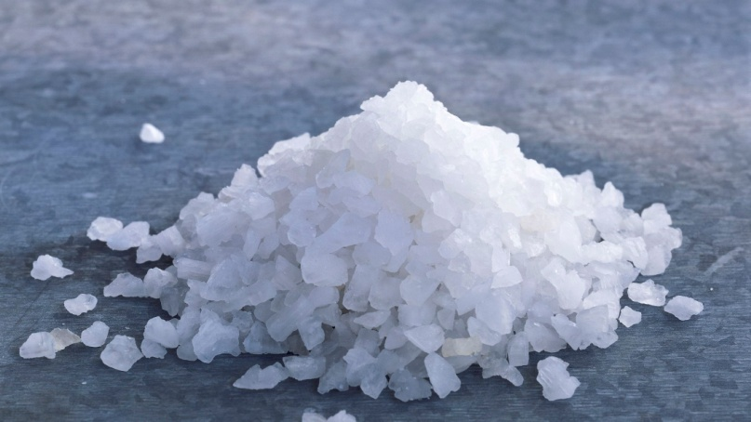
6. Sodium (Na)
Sodium is the predominant extracellular cation in animals and humans. An adult human has about 105 g Na, about 24% is located in bone and about 65% in extracellular water.
Sodium ion equilibrium is maintained primarily by the kidney, the key organ in water and electrolyte balance. Sodium chloride (salt) is the predominant dietary source.
The excessive Na intake results in elevated blood pressure (hypertension).
Sodium Chloride (NaCl)
7. Potassium (K)
An adult human has approximately 140 g K of which > 90% is both intracellular and exchangeable (K is the predominant cation in intracellular water). Since muscle contains most of the body’s intracellular water, it also contains most of the K.
Since K is found in most animal and vegetable foods, dietary deficiency is exceedingly rare except under unusual conditions (such as diets very high in refined sugars, alcoholic individuals deriving most of their calories from low-K alcoholic beverages in the states of starvation etc).
7

Slide 9
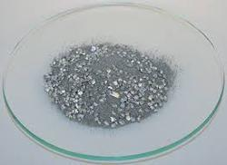
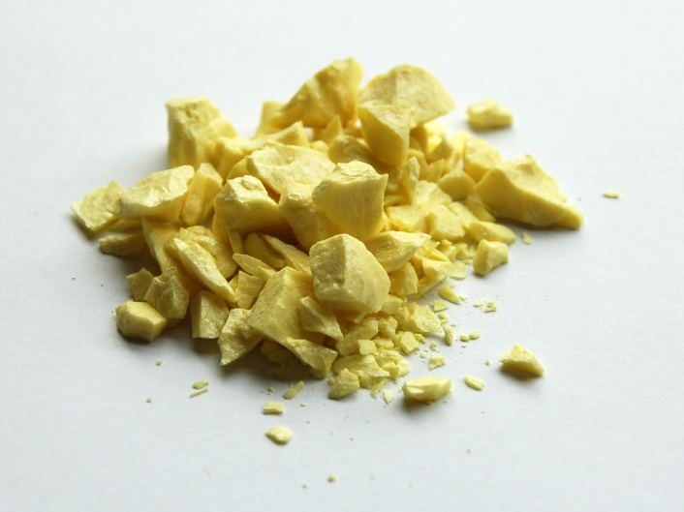
8.Magnesium(Mg)
Magnesium, an abundant element in the earth’s crust, is vital to both plant and animal life. Chlorophyll pigment in plants is a Mg-porphyrin complex.
All enzymatic reaction in animals and men that are catalyzed by ATP require Mg as a cofactor. Oxidative phosphorylation, DNA transcription, RNA function, protein synthesis and critical cell membrane functions are all dependent upon optimal Mg concentrations.
Dietary sources high in Mg include nuts, sea foods, legumes and vegetables, meat is intermediate in Mg content.
Pure Mg powder
9. Sulphur (S)
It is present in cell protein along with amino acids. It is also present along with co-enzyme A and Lipoic acid.
It participates in the structure of insulin and many more proteins. Specific sulphydryl groups of crystalline residues in some enzyme molecules are essential for catalytic activity.
Sulphur
8

Slide 10
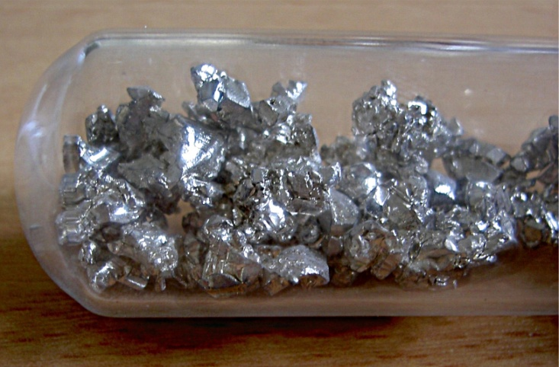
10. Calcium (Ca)
It is present in milk, eggs beans, nuts, cabbage cauliflower and aspergus. A human body needs about 800 mg of Ca daily at the age of 18 and above and below 18 age it requires 1–1.2 gm. It is major constituent of bones teeth.
About 90% of the body calcium is in the skeleton, where it is maintained as deposits of calcium phosphate which is a soft fibrous matrix. Ionized calcium is of great importance in blood coagulation. It maintains the normal excitability of heart also.
Low concentration of calcium causes irritation, weakness of bones in children (i.e. Rickets). It’s deficiency also causes Osteoporasis in adults.
Calcium (Ca)
9

Slide 11
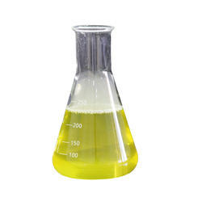
11. Chlorine (Cl)
Chlorine is taken in diet as sodium chloride. The chloride ion is essential in water balance and osmotic pressure regulation. The chloride plays a special role in the blood by the action of chloride shift.
In gastric juice, chloride shows special importance in the production of HCl acid. In loss of gastric juice by vomiting or by duodenal obstruction there is a loss of chloride ion with sodium leads to decrease the plasma chloride and increase in bicarbonate concentration resulting hypocloromic alkalosis.
Chlorine dioxide liquid
10

Slide 12
2. Trace elements
An element is called as trace elements when their requirement per day is below 100 mg and deficiency leads to disorders and may prove fatal.
Trace elements of the human body include zinc (Zn), copper (Cu), selenium (Se), chromium (Cr), cobalt (Co), iodine (I), manganese (Mn), and molybdenum (Mo).
These elements account for only 0.02% of the total body weight but they play signiﬁcant roles, e.g., as active centers of enzymes or as trace bioactive substances.
All trace elements are toxic if consumed at sufficiently high levels for long enough periods. The difference between toxic intakes and optimal intakes to meet physiological needs for essential trace elements is great for some elements but is much smaller for others.

Slide 13
Abundance of trace elements
Trace element | Earth crust (%) | Human body
Copper | 0.0068 | <0.05
Iron | 6.3 | 1.4
Manganese | 0.11 | <0.05
Cobalt | 0.003 | <0.05
Zinc | 0.0078 | <0.05
Selenium | 5*10^-6 | <0.01
Iodine | 0.000049 | <0.05
Molybdenum | 0.00011 | <0.01

Slide 14
Biological Classification of Trace Elements
Classification proposed by Frieden (1981) which divided the elements into micro, trace, and ultra-trace elements based on the amount found in tissues.
Essential trace elements: Boron, cobalt, copper, iodine, iron, manganese, molybdenum, and zinc.
Probable essential trace elements: Chromium, fluorine, nickel, selenium, and vanadium.
Physically promotive trace elements: Bromine, lithium, silicon, tin, and titanium.
Major roles played by Trace elements
Participation in the catalysis of group-transfer reactions,
Participation in oxidation–reduction reactions, or
Serve as structural components.

Slide 15
Group-Transfer Reactions
In these reactions, a recognizable functional group, such as a phosphoryl unit (−PO₃⁻), is transferred from one molecule to another.
To neutralize the negative charge on the molecule that is undergoing the reaction, many biological reactions of this type require the presence of metal ions, such as Zn , Mn , Ca , or Mg and occasionally Ni or Fe . The effectiveness of the metal ion depends largely on its charge and radius.

Slide 16
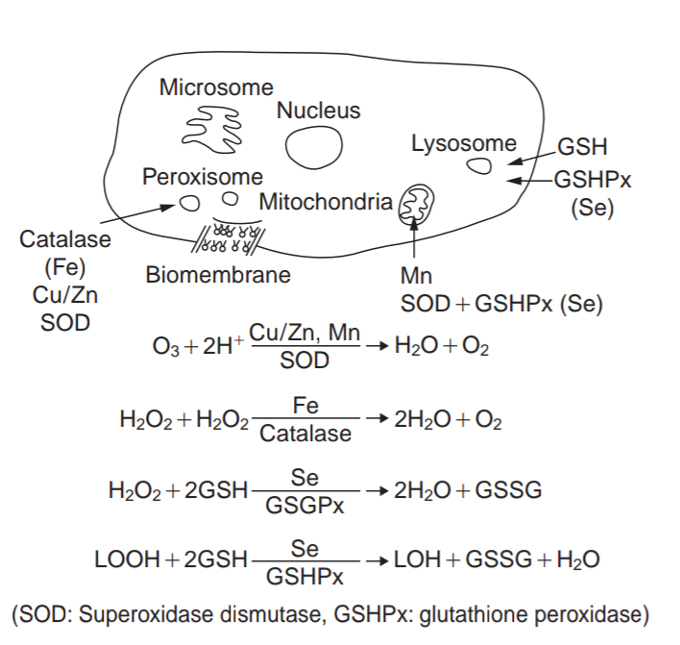
Biological Oxidation–Reduction Reactions
An important role of trace elements is to transfer electrons in biological oxidation–reduction reactions.
Because most transition metals have multiple oxidation states separated by only one electron, they are uniquely suited to transfer multiple electrons one at a time. Examples include molybdenum (+6/+5/+4), which is widely used for two electron oxidation–reduction reactions, and cobalt (+3/+2/+1), which is found in vitamin B12.
Many of the p block elements are well suited for transferring two electrons at once. Selenium (+4/+2), for example, is found in the enzyme that catalyzes the oxidation of glutathione (GSH) to its disulfide form (GSSG):
2 GSH + H2O2 2 H2 O + GSSG

Slide 17
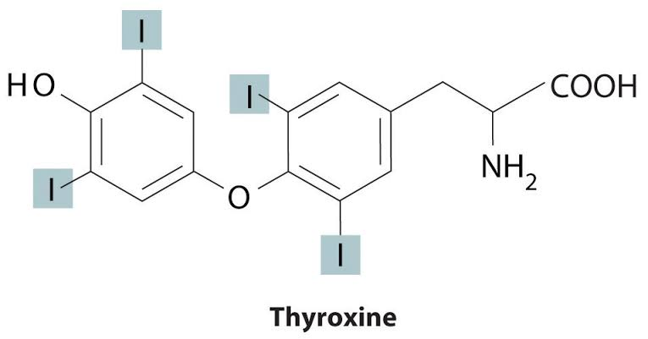
Structural Components
Zinc is an important component of enzymes that catalyze the hydrolysis of proteins, the addition of water to CO to produce HCO and H , and most of the reactions involved in DNA and RNA synthesis, repair, and replication.
Some nonmetallic elements also have structural roles. Fluoride, for example, displaces the hydroxide ion from hydroxyapatite in bone and teeth to form fluoroapatite [Ca (PO ) F]. Fluoroapatite is less soluble in acid and provides increased resistance to tooth decay.
Similarly iodine in humans is found in only one molecule, the thyroid hormone thyroxine.

Slide 18
Copper
Third most abundant trace element with only 75–100mg of total amount in the human body
Present in almost every tissue of the body, highest concentrations are found liver, kidney, heart and brain.
Biological functions:
plays a vital role in energy production during aerobic respiration (enzyme cytochrome c oxidase)
detoxifies superoxides by converting them to O2and H2O2 (enzyme superoxide dismutase)
takes part in the synthesis of collagen and elastin (lysyl oxidase)
plays role in the production of hemoglobin (Ceruloplasmin)
Melanin production: copper containing enzyme tyrosinase converts tyrosine to melanin
required for the production of the thyroid hormone thyroxine
act as both an antioxidant and a prooxidant
Deﬁciency state diseases:
X-linked inherited disorder called Menke’s syndrome (Kinky or steely hair syndrome), anemia and defective keratinisation in the oral cavity, Bone abnormalities and pain

Slide 19
Zinc
second most abundant transition metal in organisms, 2–4 grams of Zn distributed throughout the human body
stored in prostate, parts of the eye, brain, muscle, bones, kidney, and liver
Biological Functions:
required for the catalytic activity of a large number of enzymes
Plays an important role in immune function, wound healing, protein synthesis, DNA synthesis, and cell division
Required for proper sense of taste and smell
supports normal growth and development during pregnancy, childhood, and adolescence.
Deficiency state:
Human Zn deficiency in an inherited form in infants is termed acrodermatitis enteropathica and is characterized by behavioral disturbances, diarrhoea, hair loss and severe peri-orificial skin rash, all of which respond with remarkable promptness to Zn administration.
Delayed wound healing, dwarﬁsm, Growth retardation

Slide 20
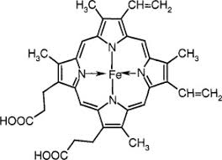
Iron
about 4-5 g Fe average human adult
most of iron is found in the blood and the rest in the liver, bone marrow, and muscles in the form of heme.
Biological Functions:
There are numerous enzymes associated with iron, namely, cytochrome c reductase, catalases, peroxidases, xanthine oxidases, tryptophan pyrrolase, etc.
Heme forms covalent bonds with the globin protein to form hemoglobin which is the major oxygen carrying pigment in RBCs of mammalians. It takes part in a myriad of metabolic cycles such as in the energy producing reactions in all the cell.
It is also necessary for DNA, RNA, collagen, antibody synthesis, and so forth.
Deficiency state: anemia
Excess state: vomiting, pallor, shock, circulatory collapse, coma, siderosis (iron is deposited in tissues and organs of the body)

Slide 21
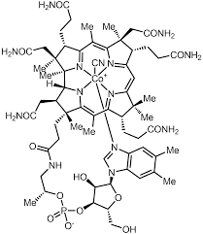
Cobalt
Only a little over 1 mg Co is present in an adult human
main component of vitamin B12 (Cobalamin). Vitamin B12 is synthesized only by bacteria. It enters the human food chain from animal sources such as meat.
Biological Functions:
Erythropoietin, essential for formation of erythrocytes, stimulation is performed by vitamin B12 containing cobalt salts.
Cobalt is necessary for the efficient formation of amino acids and various proteins for myelin sheath generation and in generating neurotransmitters.
Deficiency state: Pernicious anemia, Methylmalonic acidemia
Excess state: Increased action of thyroid and bone marrow resulting in over production of erythrocytes, fibrosis in lungs, and asthma.

Slide 22
Chromium
The total body content of chromium is relatively low and is about 0.006g in an average healthy human adult.
Biological Functions:
Chromium [Cr(III)] increases the efficacy of insulin and stimulating glucose uptake from the muscles and other tissues being the main ingredient of glucose tolerance factor (GFT).
it is one of the key minerals in controlling blood sugar and lipid levels.
As chromium is present in very low amounts in the body, it is difficult to ascertain the deficient state. It is believed that if concentrations of chromium are lower than the normal value of 0.14–0.15ng/mL in serum, this will indicate the presence of a severe chromium deficiency.

Slide 23
Molybdenum
Molybdenum is present in very small quantities.
In tissues with higher concentration, such as bone, liver and kidney, Mo content can be varied with dietary intake.
Biological Functions:
Molybdenum, as a component of molybdoprotein, takes part in the formation of active sites for various enzymes. The three principal molybdenum containing enzymes are xanthine dehydrogenase/oxidase, aldehyde oxidase, and sulphite oxidase.
A molybdenum containing enzyme has some role to play in purine catabolism. It also influences protein synthesis and growth of the body.
Deficiency state: Mo is part of the enzyme sulphite oxidase, an inherited deficiency of which cause severe neurologic disorders and early death in humans. However, no naturally occurring Mo deficiency has ever been documented in animals or man.
Molybdenum has an antagonistic effect against copper; thus, high concentrations of molybdenum can reduce copper absorption and subsequently lead to copper deficiency.

Slide 24
Iodine
vital trace element, required at all stages of life especially during formative years.
Biological Functions: Iodine is an essential component of thyroid hormones, that is, tetraiodothyronine (T4 or thyroxine) and triiodothyronine (T3). It plays a significant role in the functioning of the parathyroid glands. It plays an important role in general growth and development of the body along with maintaining metabolic processes.
Fluorine
Fluorine makes negligible part of body weight and enters the system principally through drinking water and to a lesser extent through foods.
Biological Functions: Fluorine, in the form of fluorapatite crystals, is an important part of the organized matrix of hard tissues like bone and teeth. It is also believed that fluoride, in combination with calcium, stimulates osteoblastic activity.

Slide 25
Non-Essential Elements
Elements that do not play any active role in biological systems and life processes are categorized under Non-Essential Elements.
Common examples of non-essential elements are Aluminium (Al), Silicon (Si), Titanium (Ti), Zirconium (Zr), Strontium (Sr), Barium (Ba) and Tin (Sn).
Absence of these elements do not cause any major effect on the biological system. Other essential elements can emulate their behaviour and serve their purpose.
Since most of non-essential elements forms insoluble oxides at biological pH and unstable complexes with complexing agents of biological significance, they are non-toxic are normal levels.
However like all elements, they can be toxic at very high levels.

Slide 26
Abundance of Non Essential Elements
Most of the non-essential elements are fairly abundant in earth crust. It is represented in following in chart.

Slide 27
Toxic Elements
Toxicity is the measure of extent to which a substance can damage an organism. An element is considered as toxic if it impart negative effects on biological system and crucial life processes.
In general, every element is toxic at very high level. However some elements are toxic even in trace amounts. These elements are called Toxic Elements.
Most common examples of toxic elements are Mercury (Hg), Cadmium (Cd), Lead (Pb) and Arsenic (As).
Toxicity of elements is mainly due to
Blocking of essential functional groups of biomolecules, like –OH of serine, -SH of Cysteine, -N of histidine etc in amino acids residues, proteins and enzymes.
Displacement of essential metal ions in biomolecules.
Modification of active confirmation of biomolecules that render them inactive.

Slide 28
Abundance of Toxic Elements
Most of the toxic elements are very rare in earth crust. It is represented in following in chart.

Slide 29
Mercury (Hg)
Sources of pollution :: Industrial waste, Mining (Hg is trace component of many minerals), Pesticides, coal and lignite (≈100 ppm of Hg).
Cause of Toxicity :: Strong affinity (formation constant of 10¹⁶-10²²) for deprotonated thiol (-SH) group of cysteine residue that make’s up active site of many proteins and enzymes. That is why –SH is also known as mercaptan (mercurium captans). Hg⁺² is a soft acid while S of -SH is soft base so Hg⁺² strongly binds with S (strong soft acid-soft base interaction) and changes active confirmation of biomolecule.
Toxic Effects :: Hg is toxic by ingestion and inhalation, and toxicity depends upon chemical form. Inorganic soluble Hg salts are highly toxic that can cause corrosion of intestinal tract, kidney failure and even death.
Incidents :: Minamata disease in Japan in 1953-60 that is caused by Hg containing catalytic effluent released by Minimata Chemical company into Minamata Bay. 111 people who fed on contaminated fish from bay were reported of Hg poisoning of which 45 died.

Slide 30
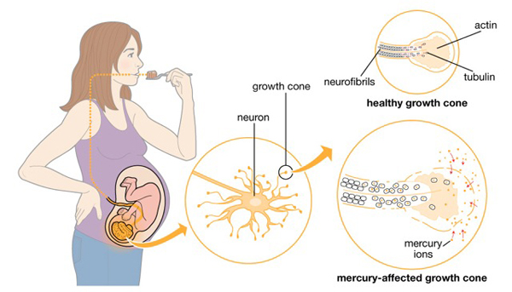

Another tragic incident occurred in Iraq in 1972, in which 450 people died after eating wheat dusted with Hg containing pesticides.
Effect of Hg on fetus growth
Minimata Disease

Slide 31
Cadmium (Cd)
Sources of pollution :: Metallurgical plants, Cd plating and battery fabricators.
Cause of Toxicity :: Cd is similar to Zn (Found naturally in association with Zn). Cd⁺² can displace Zn⁺² in many biomolecules. Cd⁺² like Hg⁺², can strongly bind to -SH of cysteine residue and alter active confirmation of enzymes and proteins like carbonic anhydrase, carboxy peptidase and dipeptidase.
Toxic Effects :: Acute Cd poisoning can cause nausea, vomiting, diarrhea and abdominal pain. Chronic Cd poisoning can cause brittleness of bones.
Incidents :: Ouch-Ouch (or Itai-Itai) Disease along Jinstu river in West Japan, caused by chronic Cd poisoning due to which, around 100 people died. Cause of this incident was a unused Zn mine along river, that contaminated river water with Cd. Water from river was used for irrigation of rice. Thereby, Cd manifested in people who ate contaminated rice.

Slide 32
Lead (Pb)
Sources of pollution :: Battery Industry, Leaded gasoline (90% lead in atmosphere) that uses tetraethyl lead (TEL) as anti knocking agent.
Causes of Toxicity :: (C₂H₅)₃Pb⁺ formed by combustion of leaded gasoline can penetrate permeable membranes like blood-brain membrane. Like Hg⁺² and Cd⁺², Pb⁺² can also inhibit –SH enzymes (but less strongly). Main cause of toxicity is ability of Pb to inhibit key enzymes in heme synthesis.
Toxic Effects :: (C₂H₅)₃Pb⁺ can cause several disorders of central and peripheral nervous system like cramps, paralysis and loss of coordination. Primary toxic effect of Pb poisoning is anemia as it inhibits heme synthesis and reduces healthy red blood cell count in blood.

Slide 33
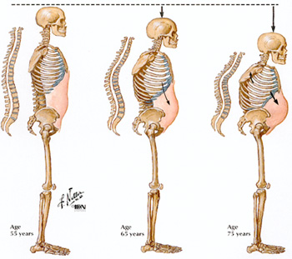
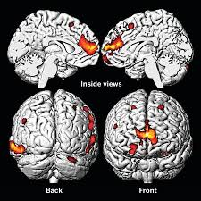
Penetration of (C₂H₅)₃Pb⁺ in brain
Itai-Itai Disease

